Slide 1
Welcome Parents and Guardians
Ms. Garfield’s
Back to School Night in the Art Room
Email: maura.garfield@apsva.us

Slide 2
About Me:
Education
B.A. Studio Art & Art Education University of Maryland, College Park
(2008-2012)
Recently moved to Virginia after teaching Elementary Art for Montgomery County Public Schools in Maryland
Spent the summer working on my own paintings!

Slide 3
Where you can reach me:
maura.garfield@apsva
Or call the school to make an appointment
703-228-7670

Slide 4
Values I practice in my classroom every day…
Compassion
Responsibility
Diversity
Integrity
Respect
Empathy
Problem solving
Kindness (helpfulness/sharing)

Slide 5
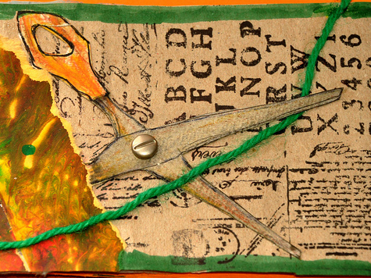
Grading Policies/Evaluation
All academic achievement will be evaluated based on the Virginia Standards of Learning for Visual Arts http://www.doe.virginia.gov/testing/sol/standards_docs/fine_arts/2013/visual_arts/std_finearts_visualarts.pdf

Slide 6
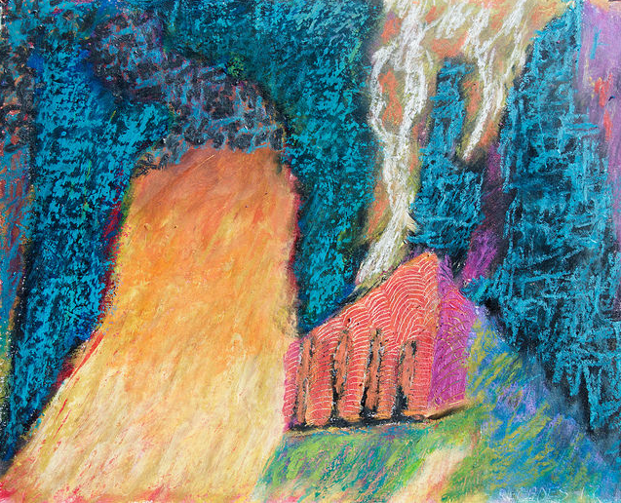
What your children will learn this year…
I hope to channel your child’s natural artistic development and encourage art as a lifelong interest. They will learn that what they create is unique, and therefore worth doing.

Slide 7
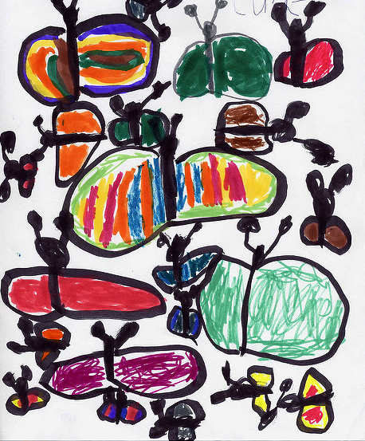
What your children will learn this year (cont.)
Drawing and Illustration Skills
Color Theory
Ceramics, Sculpture, 3-D Design
Aesthetics
Art History, and Art Criticism

Slide 8
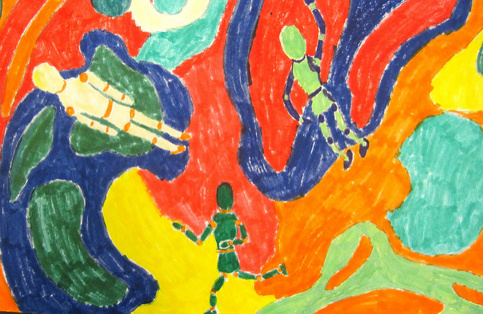
Resources to share with your children at home if they are interested in art…
Try these apps at home –
KaleidaCam
Colorscape
Doodle Art
Let’s Create Pottery
Creatubbles

Slide 9
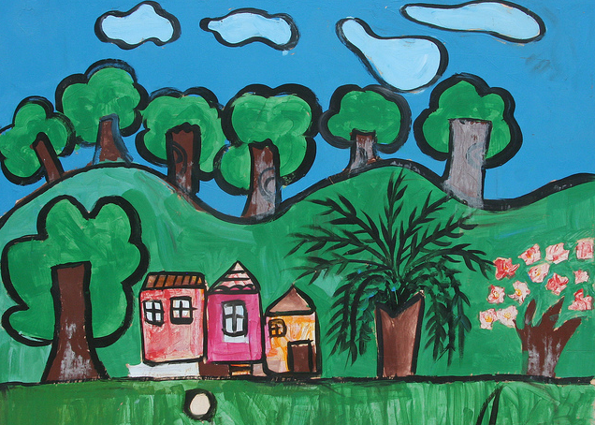
Donations
The following items are always useful in the art classroom if you are interested in recycling ☺
Paper towel rolls
Plastic containers
Art-related books
Sponges
Tissues
Family-appropriate magazines for collages

Slide 10
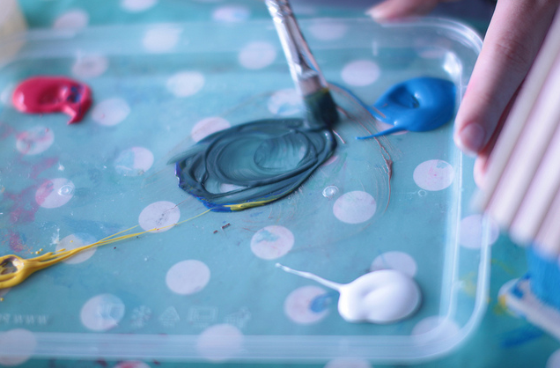
Interested in Volunteering?
Please send me an email at maura.garfield@apsva.us if you are interested in volunteering to help during the week, or for a particular even such as the art show.

